Slide 1
Boxcars – an NS Perspective
Paddy o’neill Senior Director Fleet Planning & Optimization

Slide 2
We love boxcars - LOTs
They carry LOTS of stuff
They carry LOTS of stuff
They go LOTS of places
They get used by LOTS of railroads and LOTS of customers
Notes:
Let me start by being very clear – the NS perspective on boxcars is: We LOVE them LOTS
They can hold an awful lot of stuff in 60’ of Plate F capacity
They carry lots of differents stuff – paper, pulp, beer, wine, autoparts, bricks, canned food…
They go pretty much everywhere
And pretty much any railroad or shipper who wants to use one can
We love them so much we’ve acquired over 800 a year for the past three years and over 400 so far this year. Plus we’ve already signed up for more to come in the near future
Let me be clear: The NS perspective is we LOVE boxcars

Slide 3
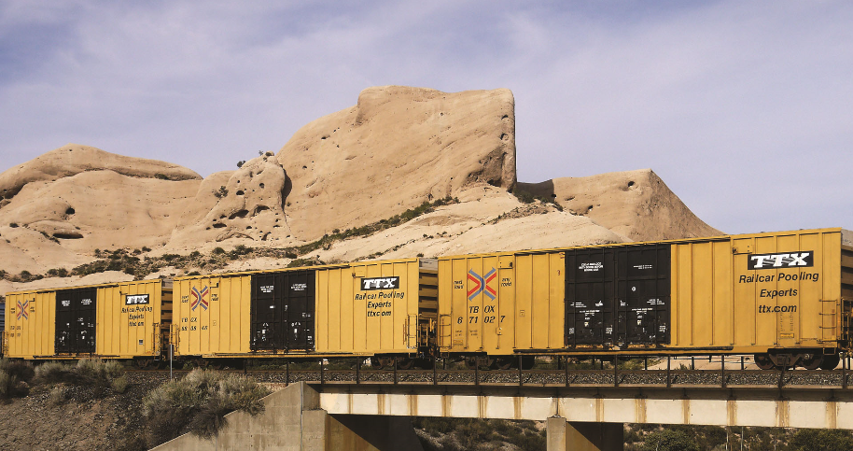
Current Discussion around boxcars
Will there be enough?
How will they be paid for?
Notes:
And right now there’s a lot of discussion around them. That discussion centers around two points:
Will there be enough boxcars when they’re needed, and
How will they be paid for
I’m going to address these separately, because I believe they really are two separate questions.

Slide 4
North American Boxcar Fleet – No Replacement
Source: TTX / Umler. Excludes refrigerated boxcars
Notes:
Starting first with the supply question, everyone who has contemplated the North American boxcar fleet has seen a graph which looks something very much like this. And given this is not the first time this discussion has arisen, this is actually a graph from March 2015 which I used at the annual Rail Equipment Finance conference in March of that year. Then in June of 2015, this came out:

Slide 5
Why can’t railroads keep enough cars in service
WSJ – June 21, 2015
“The boxcar supply is less than demand.”
Glen Courtwright, Georgia Pacific
“There is a looming crisis.”
David Friedson, Evergreen Packaging
“There’s just no consensus on what’s required to create an economically viable boxcar fleet.”
Richard Kloster, AllTranstek
Notes:
This hit the front page of the Wall Street Journal. Why Cant the Railroads Keep Enough Cars in Service. Yeah, it was great. So this is definitely a discussion with some age to it.

Slide 6
N.A. Boxcar Fleet
NET Pre-50 year Boxcar Reduction
“Standard” Boxcars
Plate F Boxcars
Source: TTX / Umler. Excludes refrigerated boxcars
Notes:
Focusing on a more relevant timeframe here’s how the fleet looked for the past few years. Plate F cars are in black. The blank boxes at the top of the stack are fallouts beyond which the age alone would have projected in 2015. So the fleet is marginally smaller than it might otherwise have been. The gross fallout was actually even larger. Though none were built in 2015, in the subsequent three years, TTX built an average of 2,700 high capacity cars/year while other owners built an average of 675/year.

Slide 7
N.a. Boxcar Fleet – projected with no replacement
Source: TTX / Umler. Excludes refrigerated boxcars
Notes:
Going forward, if we assume that cars make it to their 50 year life AND no more cars are built, the fleet size would evolve like this. However, those are both probably really bad assumptions. Meaning some cars are almost assuredly going to be built and some cars simply won’t make it to their 50 year end of life.

Slide 8
N.a. Boxcar Fleet – Average 2016 -2018 Builds Projected
Source: TTX / Umler. Excludes refrigerated boxcars
Notes:
Alternatively if we assume cars will be built at the average rate they were built for the past three years, we can see what currently seems an unlikely future scenario – a growing fleet.

Slide 9
The capacity discussion – unnecessary cars exist
In late 2018 when AAR-designated, “in storage” boxcars got to their lowest point, it was still over 12,000 cars.
Notes:
So before we do any more future projections, let’s add some additional flavor. Even when things were at their tightest last year, 2018, over 12,000 boxcars across the industry remained in storage. If the number of cars stored never dipped below 12,000 in any month of 2018, it is perhaps reasonable to assume there are at least 10,000 too many boxcars. That’s a number you can disagree with, but for purposes of today’s discussion, it’s one we’ll use.

Slide 10
The capacity discussion – new cars carry more
In late 2018 when AAR-designated, “in storage” boxcars got to their lowest point, it was still over 12,000 cars.
New cars are almost exclusively Plate F, 100T cars.
Weight: +40%
Cube: +20% to +40%
Almost all the projected fallout is in lower capacity cars
Notes:
New cars are higher capacity. Some may initially under-utilize the full new capacity, but rather quickly I suspect everyone will figure out how to make the most of each load.

Slide 11
The capacity discussion – there are some challenges
In late 2018 when AAR-designated, “in storage” boxcars got to their lowest point, it was still over 12,000 cars.
New cars are almost exclusively Plate F, 100T cars.
Weight: +40%
Cube: +20% to +40%
There are valid concerns about capturing the full benefit:
Plate F is not high enough to double stack some items – so only a 20% length benefit
Some dock doors are on 50’ centers, so potentially a loss of loading spot capacity
Plate F has clearance concerns at some locations
Notes:
There are valid concerns about being able to initially utilize a new boxcar’s full capacity. I would add to this list the challenge for our shippers and receivers to change order books from 50’, Plate C size orders to 60’, Plate F size orders.
We, the NS, have helped successfully overcome many of these challenges including an interstate highway overpass as we help increase our adoption of the 60’, Plate F, 100T car.

Slide 12
The capacity discussion – Pooling helps
In late 2018 when AAR-designated, “in storage” boxcars got to their lowest point, it was still over 12,000 cars.
New cars are almost exclusively Plate F, 100T cars.
Weight: +40%
Cube: +20% to +40%
Pools are available for three car types
50’, 70T, Plate C
50’, 100T, Plate F
60’, 100T, Plate F
Notes:
The next part of the capacity discussion is pooling which both increases total capacity and provides some insight into the affordability question. The North American Boxcar Pool is open to any railroad and has collections of three different boxcar types here.

Slide 13
How does pooling help? Total Fleet & carloads
Source: TTX / Umler / RailInc. Excludes refrigerated boxcars
Notes:
This adds the loads carried to the fleet size. Doing a little math helps us understand how efficient the fleet has been.

Slide 14
The total boxcar fleet makes about 9.9 trips per year
Source: RailInc / Umler. Excludes refrigerated boxcars
Notes:
Each boxcar on average is carrying a little more than 9.9 loads/year. However this lumps in all the boxcars, and we started talking about pooled boxcars.

Slide 15
Cars pooled so anyone can use them are better utilized
Source: RailInc / Umler / NABP. Excludes refrigerated boxcars
Notes:
Pooled boxcars carry 11.1 carloads/year. You’ll also note that the utilization has been trending downward. That is a result of the builds and increased pool sizes as many of the Class I railroads have been pushing into the 60’ F boxcar.

Slide 16
NABP cars make 11.1 trips per year
Having cars in NABP allows triangulation and creates a 16% increase in utilization.
The North American fleet excluding NABP makes 9.6 trips per year.
Source: RailInc / Umler / NABP. Excludes refrigerated boxcars
Notes:
Taking the NABP cars out of the total fleet drops the “everything else” fleet to 9.6 trips per year.

Slide 17
Boxcar pooling’s benefit quantified
Measure | Non-pooled | Pooled
Trips per Year | ~9.6 | ~11.1
Notes:
The NABP provides some serious capacity benefit relative to non-pooled cars. We just saw these figures

Slide 18
Boxcar pooling’s benefit quantified
Measure | Non-pooled | Pooled
Trips per Year | ~9.6 | ~11.1
Empty / Loaded Miles | ~100% (by definition) | 50%-75%
Users | Typically 1 | LOTS
Notes:
Empty miles are reduced by a quarter to one half. And the opportunities to catch a next load are greater as we open up the pool of users.

Slide 19
Boxcar pooling’s benefit quantified
Measure | Non-pooled | Pooled
Trips per Year | ~9.6 | ~11.1
Empty / Loaded Miles | ~100% (by definition) | 50%-75%
Users | Typically 1 | LOTS
The North American Boxcar Pool is open to all railroads
All Class I’s and one Class III participate as members
Many other roads use NABP cars provided by Class I’s
Notes:
NABP is available to all railroads, and hence all shippers can have access to more efficient shipping.

Slide 20
What size fleet is needed?
Today’s fleet is 108,000 of which 20,000 are currently stored
9,000+ (of the stored cars) are 40 or more years old
Even at peak demand 12,000+ cars didn’t carry a load
Assume 10,000 of the idle cars are unnecessary/unusable
Assume the size provides a 30% benefit based on
Weight: +40%
Cube: +20% to +40%
Assume 50% of the cars falling out can be pooled and get a 16% utilization bump
Notes:
Let’s make some assumptions to size the true need of the boxcar fleet,
Earlier I noted that 12,000 cars – even at the height of demand – didn’t carry a load – so assume 10,000 are just plain unnecessary
The new cars are capable of carrying significantly more. Over time competitive forces will help all shippers achieve fuller use of the available capacity. So i’m assuming a 30% gain
I also talked about the benefits of pooling. Here I assume only ½ cars falling out would be replaced by a pooled car capturing the 16% benefit – an extremely conservative estimate. In reality, I think the network effect of pooling combined with better aligning supply and demand is likely to be significantly higher.

Slide 21
N.a. Boxcar Fleet – How many are needed?
2019 to 2029 Age Outs
Notes:
Getting into the details now, here are the current and projected fleet sizes.

Slide 22
N.a. Boxcar Fleet – How many are needed?
10,000
42,200Age Outs
32,200
Notes:
I’m taking 10,000 cars out as being simply unnecessary. This creates a replacement bogey of 32,200 cars.

Slide 23
N.a. Boxcar Fleet – How many are needed?
10,000
42,200Age Outs
32,200
24,000
Notes:
Let’s assume only 24,000 cars are built to replace those falling out.

Slide 24
N.a. Boxcar Fleet – How many are needed?
10,000
1,900
42,200Age Outs
32,200
7,200
24,000
Notes:
If we add in the 30% size benefit and a 50% of 16% pooling benefit, we get a total equivalent of 9,100 more cars.

Slide 25
N.a. Boxcar Fleet – How many are needed?
10,000
1,900
42,200Age Outs
32,200
7,200
33,100
24,000
Notes:
All in the build of 24,000 over the next decade more than covers the need.

Slide 26
N.a. Boxcar Fleet – How many are needed?
10,000
1,900
42,200Age Outs
32,200
7,200
33,100
24,000
With a possible build of 24,000 boxcars over the next decade, we’ll need to slow the build rate, accelerate the retirements or increase demand to meet supply!
Notes:
Given the average build over the past three years was 3,400 cars, we’ll have to slow the build by nearly 1,000 cars / year to only build 24,000. We can also consider accelerating the retirements to better align supply with demand or my favorite – increase demand to meet supply!
Quite simply, there is not a shortage of cars.

Slide 27
The PSR effect on Norfolk southern’s nabp fleet
Indexed to 100 as of 3/31/2015
Notes:
None of the preceding analysis relies on or assumes faster railroad performance – none of it. I’m showing this simply to add some delicious icing to the wonderful cake of no need to worry about boxcar capacity. Another way to look at this is to assume NS was getting 11.1 TPY and with the PSR boost is currently getting 13.9 TPY.
And car velocity really matters. On January 28th, 2014 it snowed in Atlanta. My wife left home at noon to drive the 8 miles to school to pick up our kids.

Slide 28
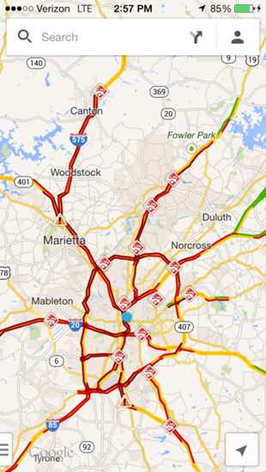
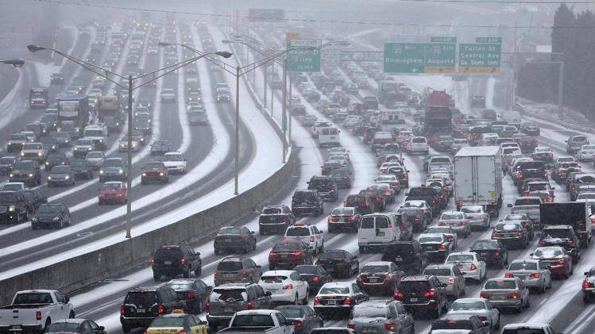
Sometimes “more cars” worsens the problem
Notes:
At 5:30 she got there. She decided that was enough and spent the night in the school gym with four other parents and 30+ kids whose parents couldn’t get there. Pretty clearly velocity is a huge contributor to capacity.
And so while there have been episodic events of boxcar capacity shortage - some of them prolonged episodes - I submit they were NOT car quantity problems which you experienced.
So understanding there are plenty of cars, why all the ruckus?

Slide 29
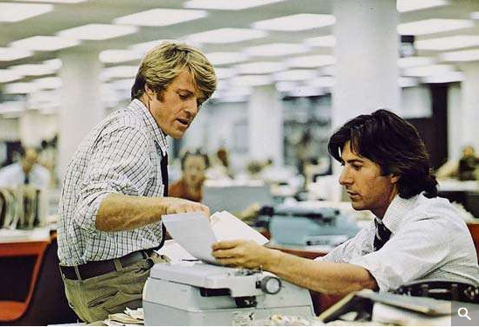
So if there are plenty of cars, what’s all the noise about?
“Follow the money.”
Notes:
In the words made immortal in All the President’s Men, when Bob Woodward says he and Bernstein can’t seem to put the puzzle pieces together, Deep Throat tells him to “Follow the money.” So let’s do that here.

Slide 30
Car hire rates were once regulated
In 1970 the ICC set formula based car hire rates – what one railroad pays another for the use of a car.*
Prior to that, car hire rates were set by “railroads working through the AAR”**
The ICC regulated rates considered “the expense of owning and maintaining that type of freight car, including a fair return on its cost giving consideration to current costs of capital, repairs, material, parts and labor.” (49 U.S.C. § 11122)
*Car Service Compensation – Basic per diem Charges – Formula Revision in Accordance with the Railroad Revitalization and Regulatory Reform Act of 1976 (page 4)(Aug. 1, 1977)
**Changes Needed in Procedures For Setting Freight-Car Rental Rates, United States General Accounting Office, (Page ii) (Nov. 11, 1977)
Notes:
In the 1800’s railroads based car compensation on miles traveled. In 1902 they switched to flat daily rates. Then in 1964, they switched to daily rates based on car cost.***
Here’s a general timeline of how car hire used to be set. The AAR’s process faded out and the ICC stepped in somewhere between 1968 and 1970.
***US General Accounting Office, “Changes Needed in Procedures for Setting Freight-Car Rental Rates” November 11, 1977, page 4

Slide 31
It didn’t go well
US Court of Appeals: “The ICC’s approach was a flop…Despite rampant car surpluses in the early 1980’s, for example, car hire rates increased – leading to still greater car surpluses. In 1985, the ICC suspended annual updates to the car hire rates and sought comments on possible solutions to the formula’s difficulties.”*
ICC Commissioner Phillips: “Not only is the present system not working, it is working in reverse. Rates are higher in times of car surplus and lower in times of car shortage.”**
*Opinion of the US Court of Appeals, District of Columbia Circuit, Southern Pacific Transportation Company v. Consolidated Rail Corporation, et al., Intervenors (page 2)(Decided Nov 7, 1995)
**Joint Petition for Rulemaking on Railroad Car Hire Compensation, 9 I.C.C. 2d 80, (Page 92) (Oct. 23, 1992).
Notes:
I was somewhat surprised to see one branch of government calling another’s process a flop, but perhaps I don’t read enough judicial decisions. Anyway, a guaranteed return on investment didn’t go well for anyone except perhaps the investors.

Slide 32
the industry collaborated to move to market rule
Referencing the multi-year, full industry participation in creating a market based process, ICC Commissioner Phillips commented “A great deal of effort went into the development of this proposal by numerous rail industry interests to replace Commission regulation with a reliance on marketplace forces…”*
He added “I continue to be troubled by…the exclusion of Class III boxcars from this deprescription system.”*
Railroad marked cars were deprescribed between January 1993 and December 2002.
*Joint Petition for Rulemaking on Railroad Car Hire Compensation, 9 I.C.C. 2d 80, (Page 92) (Oct. 23, 1992).
Notes:
By 1985 the wheels had come off, and the industry was moving towards a market based system. The eventual solution, known as deprescription, was phased in over a decade.

Slide 33
car building has continued in the deprescription era
Source: ARCI Committee of the Railway Supply Institute as cited by National Steel Car at Rail Equipment Finance, Mar, 2019
Notes:
Pretty clearly the process of allowing market forces to determine what railroads pay each other for their cars has not deterred rail car investment
In a quite good presentation done by GATX at 2017’s MWARS, there is a line helping to explain some of this phenomenon: “Despite the negatives, money in search of yield can’t seem to stay away from railcars.”

Slide 34
Cars built have covered the spectrum – including boxcars
Source: RailInc
Notes:
And the investment has occurred across the spectrum of car types.

Slide 35
Default rates cover newly built cars not yet negotiated
New cars automatically get a rate equal to the lowest negotiated rate of the previous quarter for that car type.
During the deprescription process, the ICC said: “For new cars with no prior rate history, the default rate was initially set at zero. Later, after considering various options, including the ‘average negotiated rate’ option that the Coalition apparently favors, proponents proposed, and we approved in the 1992 Final Decision, the lowest positive negotiated rate for that type of car at the end of the previous quarter as a default rate for cars with no prior rate history.”*
The default rate encourages the carrier to negotiate the totality of the transportation service with other involved railroads.
*Boxcar Car Hire and Car Service, 3 I.C.C. 2d 1, (Page 36) (Aug. 27, 1986).
Notes:
When new cars get built and put in railroad (as differentiated from shipper) service, they are assigned a default car hire rate. In the very quickest of cases the process to build a new car and put it in service has to be at least two months. During that interval the intended purchaser has plenty of time to negotiate car hire rates with all railroads in the route. After that it can continue negotiating with other potential future using railroads. This obviously presupposes traffic wanting to be carried by the new cars.
The default rate set at the lowest negotiated rate both keeps the rate within the market range and encourages market participants – the railroads providing the service – to negotiate the totality of the transportation service.

Slide 36
What does that leave?
So, if deprescription, doesn’t deter railcar investment, what does?
spacer
Notes:
Coming back to All the President’s Men, it’s about the money. And the answer is provided by the ICC itself.

Slide 37
What does that leave?
So, if deprescription, doesn’t deter railcar investment, what does?
Pretty clearly: nothing.
And if there is no deterrent to investment, we have to ask:
Why all the noise about boxcars, and
Why only boxcars
Notes:
Coming back to All the President’s Men, it’s about the money. And the answer is provided by the ICC itself.
And here I’m going to commit the greatest sin of presentations before a large group read you a slide. Worse yet, I’m going to read not only one slide but two. It is a necessary sin to understand why the noise is occurring and the explanation comes directly from a ICC commissioner Fred Andre.

Slide 38
Commissioner Andre’s dissenting prescience
“What is actually happening here is that a small number of car leasing companies have recently found themselves with more boxcars than the railroad industry needs. The boxcars were financed by astute investors who were able to benefit handsomely from tax breaks, the high car rental rates in the 1970’s and the boxcar shortage prior to the Staggers Act. By leasing their cars to small railroads, the owners of the boxcars are able to utilize the mandatory car interchange of the Interstate Commerce Act to force the larger carriers to accept these unneeded cars in interchange and to pay prescribed car hire rates.*
*Boxcar Car Hire and Car Service, 3 I.C.C. 2d 1, (Page 36) (Aug. 27, 1986).
Notes:
So in essence those who control the Class III boxcars can rent them to large carriers, and large carriers can’t decline either the cars or the price paid for the cars.
However, Commissioner Andre’s insight goes on:

Slide 39
Commissioner Andre continues
“The use of these boxcars has become inefficient and costly for the larger connecting carriers which provide most of the overall (end-to-end) transportation service. However, the car owners have persuaded ASLR that this inefficiency is irrelevant and that the way to prosperity is a regulatory floor on car hire rates and regulation which will force the larger carriers to pay the floor rates. I firmly believe that this attempt at a regulatory solution will end up harming its proponents by adding to market forces which are driving boxcar traffic to trucks and exempt rail service.”*
*Boxcar Car Hire and Car Service, 3 I.C.C. 2d 1, (Page 36) (Aug. 27, 1986).
Notes:
What is being proposed as changes to “save the boxcar fleet” is in fact nothing more than an effort to preserve governmental favoritism of one industry participant at the expense of all others. Whilst we certainly don’t believe that above market rates are solely responsible for the decline in boxcar demand, we do believe they coupled with the 100% reverse route nature of these cars are a significant contributor.

Slide 40
So, If you think paying for an asset you can’t control is a good idea, let’s talk…I’ll be here all day

Slide 41
However, if you’re interested in more efficient, competitive transportation, Let’s talk…I’ll be here all day!
NS is interested in helping shippers and shortlines switch to pooled cars and efficient, competitive shipping
So far the transition to the 60’ boxcar is going well. For every two standard boxcars requested by our customers they are requesting three 60’, 100T, Plate F boxcars.

Slide 42
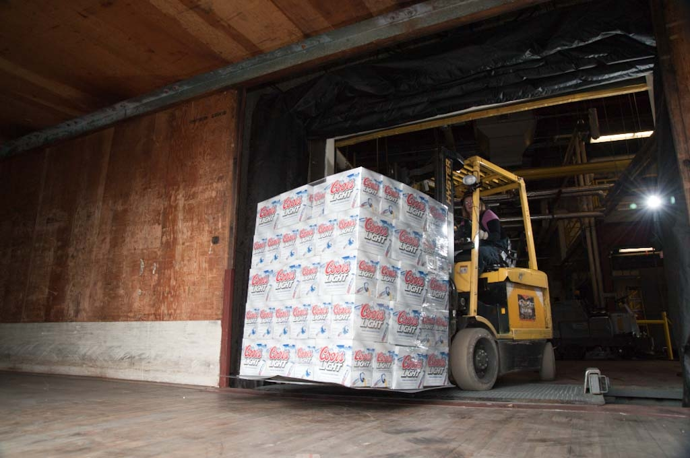
Notes:
And, though it’s still a bit early, I believe it’s time for a beer…brought to you by the boxcars of North America.

