Slide 1
Chemical Facility Anti-Terrorism Standards (CFATS)
Edit presenter’s name
and date in Slide Master
Notes:
Change Presenter’s Name and Date in Slide Master view.

Slide 2
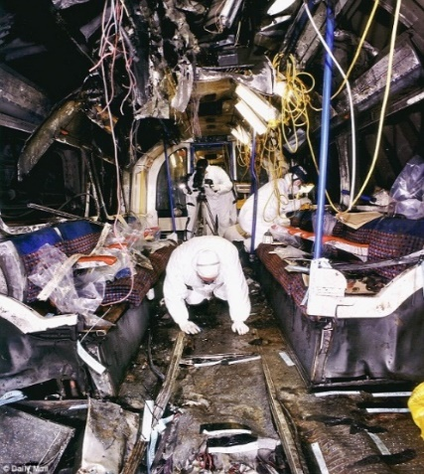
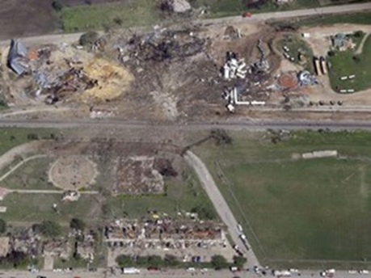
Why Chemical Facility Security?
We face a persistent and evolving threat
Subway Bombings – London
Death Toll in West, Texas, Fertilizer Explosion Rises to 15
NPR, April 23, 2013
A successful attack on a chemical facility could potentially cause a significant number of deaths and injuries
Ammonium Nitrate – Texas
Subway and Bus Blasts in London Kill at Least 37
NY Times, July 8, 2015
Certain chemical facilities possess materials that could be stolen or diverted and used for terrorist activities
Chlorine-Tinged Smoke from Detonated Bomb – Iraq
Police Block Scene of Attack – France
Kurds Report More Chlorine Attacks, Iraq Pauses Tikrit Offensive
Reuters, March 16, 2015
French Authorities Hold Suspect in Beheading and Explosion at Chemical Plant
NY Times, June 26, 2015

Slide 3
Ensuring Chemical Facility Security
Statutory Authority
In December 2006, Congress authorized DHS to regulate security at “high-risk” chemical facilities
The Department developed the Chemical Facility Anti-Terrorism Standards (CFATS), 6 CFR Part 27, to implement this authority
In December 2014, Congress extended the Department’s authority through the Protecting and Securing Chemical Facilities from Terrorist Attacks Act of 2014 - 6 U.S. Code Chapter 1, Subchapter XVI: Chemical Facility Anti-Terrorism Standards (CFATS)
In January 2019, CFATS received a 15-month extension to its current authorization

Slide 4
The CISA Structure
In 2018 Congress passed the Cybersecurity and Infrastructure Security Agency Act. Previously known as National Protection and Programs Directorate, CISA seeks to defend our Nation against the digital, physical, manmade, technological, and natural threats that we face.
Cybersecurity and Infrastructure Security Agency (CISA)
Cybersecurity Division
National Risk Management Center
Infrastructure Security Division
Federal Protective Service
Emergency Communications Division
Infrastructure Security Division (ISD)
IICD
NICC
ISCD
PSCD
SOPD
Infrastructure Security Compliance Division (ISCD) administers the Chemical Facility Anti-Terrorism Standards (CFATS) Program and the Ammonium Nitrate Security Program (ANSP)

Slide 5
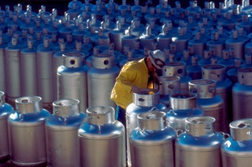
The CFATS Regulation
The CFATS program identifies and regulates high-risk chemical facilities to ensure they implement appropriate security measures to reduce the risk of a terrorist attack associated with more than 300 chemicals of interest (COI). If held in specified quantities and concentrations, these chemicals must be reported to DHS. Facilities that store, manufacture, or distribute COI at or above screening threshold quantities (STQ) are required to comply with the CFATS standards.
CFATS follows a risk-based approach, allowing DHS to focus on high-risk chemical facilities in accordance with their specific level of risk

Slide 6
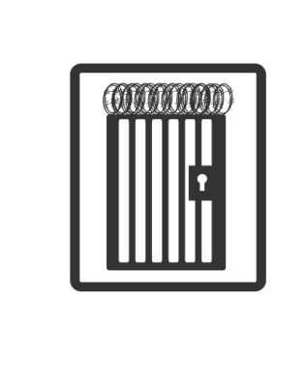
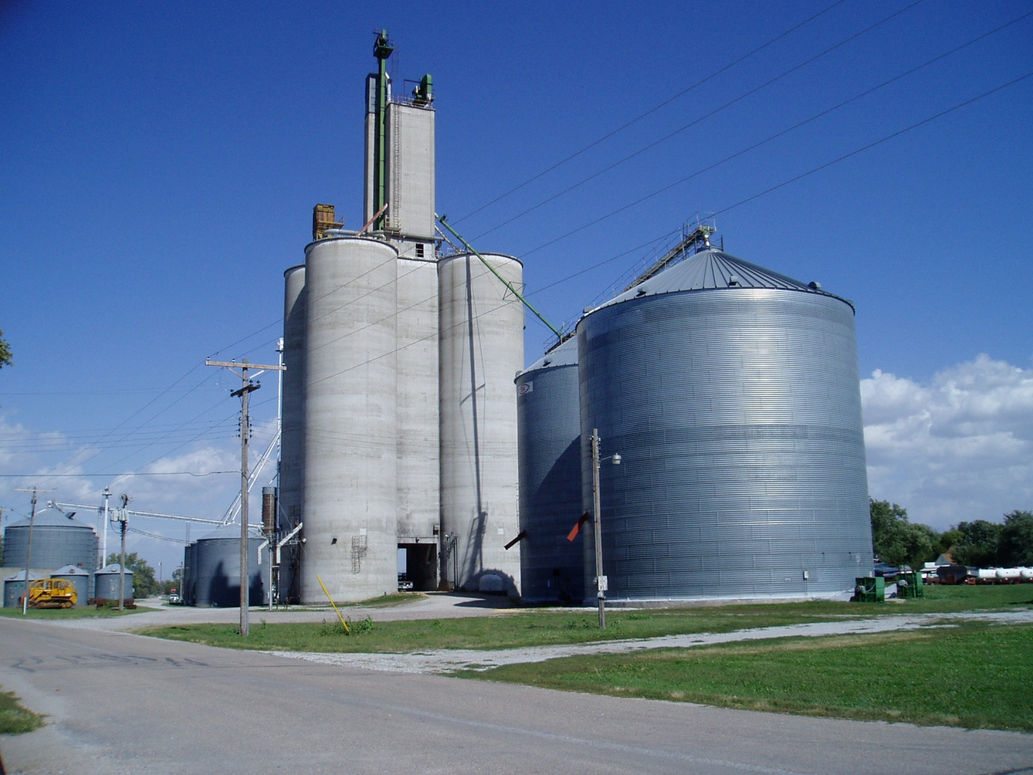
CFATS Universe
Identifying high-risk chemical facilities
Hospitals and Clinics
“Appendix A” – a list of 300+ chemicals of interest (COI) at specific threshold quantities and concentrations that require reporting to the Department
Wineries
Correctional
Facilities
Chemical Facilities Come in All Shapes and Sizes
Chemical Manufacturing
Oil Refineries
Food Processing
Wineries
Colleges and Universities
Farm Cooperatives

Slide 7
Industries with Facilities Regulated by CFATS
CFATS regulates facilities in various industries, including:
Academia (College & Universities)
Aerial Sprayers (Non-Fertilizer)
Breweries
Cold Chain/Refrigeration
Energy Utilities
Fisheries and Hatcheries
Food Processors and Co-Ops
Healthcare (Hospitals & Providers)
Laboratories
Metal Service and Metal Merchants
Mining
Motor Vehicle Parts Manufacturing
Paints/Coatings
Petrochemical Manufacturing
Petroleum Refining/Oil Drilling
Plastics
Pulp and Paper
Race Tracks
Retail Storage and Distribution
Semiconductors
Water Parks, Pools, and Filtration
Wineries
NH3
CI
AN
H202

Slide 8
Am I Exempt?
Statutory Exemptions
Facilities regulated by the Nuclear Regulatory Commission
Facilities owned by the Departments of Defense or Energy
Public water systems and water treatment works regulated under certain Federal water quality laws
Facilities regulated under the Maritime Transportation Security Act
Agricultural Production Facilities
In January 2008, DHS indefinitely extended the Top-Screen due date for agricultural production facilities

Slide 9
CFATS National Footprint
Number of Facilities, by Region
0-200 201-400 401-600 600+
Region 10
Region 8
Region 1
Region 5
Region 7
Region 2
Region 9
Region3
Region 4
- Hawaii
(Region 9)
Region 6
- Guam (Region 9)
Puerto Rico (Region 2)

Slide 10
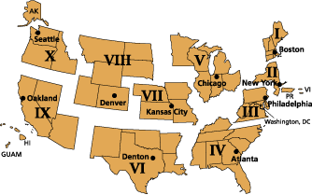
Program Status: Region 4
Currently Covered Facilities | 658
Currently Authorized Facilities | 61
Currently Approved Facilities | 568
Currently Tiered Facilities (awaiting authorization and approval) | 29
Total Authorizations Inspections | 781
Total Compliance Inspections | 988
Region 4 Includes:
Alabama
Florida
Georgia
Kentucky
Mississippi
North Carolina
South Carolina
Tennessee

Slide 11
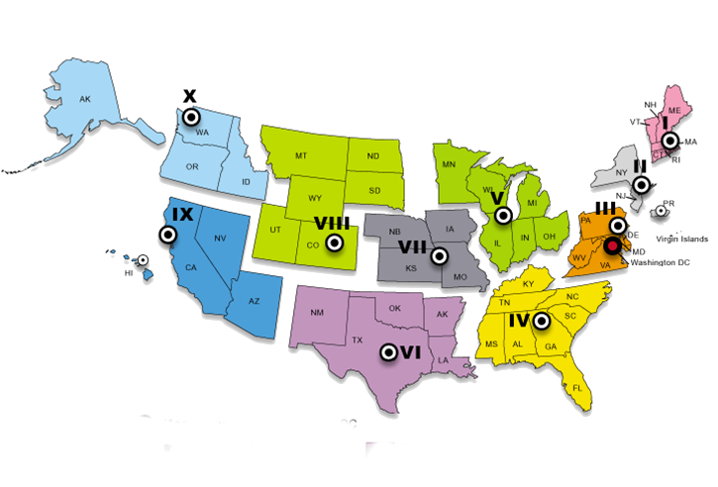
Essentials of the CFATS Program
Facilities in possession of Chemicals of Interest at or above the screening threshold quantities and concentration must submit a risk assessment
DHS uses information submitted through the online risk assessment (Top-Screen) to determine if a facility is high-risk / covered
Covered facilities are placed in one of four tiers
Tier one represents the highest risk
Covered facilities are required to develop and implement security plans that meet applicable risk-based performance standards (RBPS)
Chemical Security Inspectors assigned to all 50 States and U.S. territories conduct inspections, assist with compliance, and perform outreach

Slide 12
Chemical Security Inspectors
Chemical Security Inspectors are located in all 50 States
More than 150 Chemical Security Inspectors
Organized into teams in each of the 10 Federal regions
Conduct:
Authorization Inspections
Compliance Assistant Visits
Compliance Inspections
Stakeholder Outreach
Chemical Security Inspectors also attend meetings with Federal, State, local, and private industry members

Slide 13
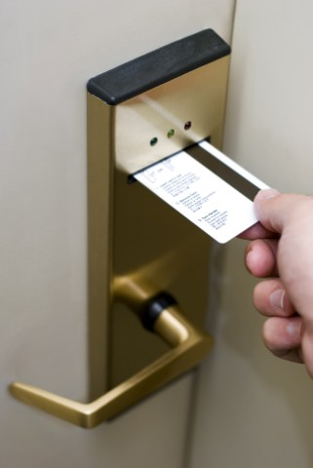
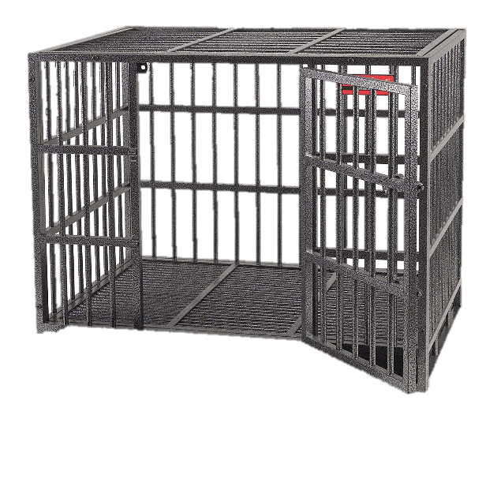
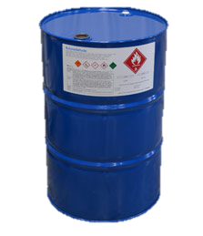
Risk-Based Performance Standards
Risk-Based Performance Standards (RBPS) are the foundation of a facility’s Site Security Plan and drive the security standards at all tiered facilities.
RBPS provide facilities with flexibility and allow for the use of existing or planned measures, ideas, and expertise where appropriate.
A covered high-risk facility has to satisfy the applicable RBPS by implementing security measures appropriate to the facility’s risk tier.
Security measures appropriate to satisfy the RBPS will vary from one facility to another based upon level of risk and unique facility circumstances.

Slide 14
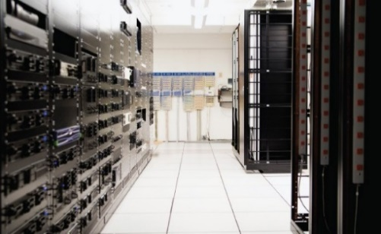
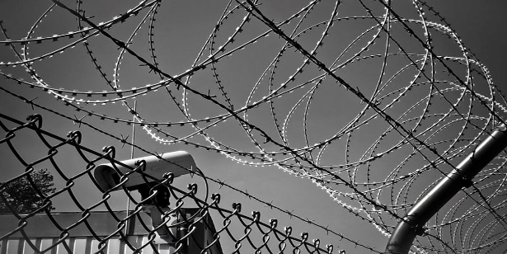
Risk-Based Performance Standards
1) Restrict Area Perimeter
2) Secure Site Assets
3) Screen and Control Access
4) Deter, Detect, Delay
5) Shipping, Receipt, and Storage
6) Theft and Diversion
7) Sabotage
8) Cyber
9) Response
10) Monitoring
11) Training
12) Personnel Surety
13) Elevated Threats
14) Specific Threats, Vulnerabilities, or Risks 15) Reporting Significant Security Incidents
16) Significant Security Incidents and Suspicious Activities
17) Officials and Organization
18) Records
RBPS-10 Monitoring
Rather than prescribe specific facility security measures, DHS developed 18 Risk-Based Performance Standards (RBPS)
RBPS-8 Cyber
Compliance with the RBPS will be tailored to fit each facility’s circumstances, including tier level, security issues, and physical and operating environments
RBPS-1 Restrict Area Perimeter

Slide 15
RBPS 12: Personnel Surety
Personnel Surety includes vetting individuals with access to COI and other sensitive parts of high-risk chemical facilities
I. Identity
II. Criminal History
III. Legal Authorization to Work
IV. Terrorist Ties
Risk-Based Performance Standard 12
requires background checks, including recurrent vetting against the Terrorist Screening Database
In May 2019, OMB approved CISA’s ICR for implementing the CFATS Personnel Surety Program for all covered chemical facilities, to include Tiers 3 and 4.

Slide 16
Options for Compliance
DHS began implementation of the Personnel Surety Program in December 2015. Tiered facilities have four ways to implement terrorist screening provisions:
Option 1*
Option 3
Option 4
Direct Vetting
Option 2*
Use of Vetting Conducted Under Other DHS Programs
Electronic Verification of TWIC
Visual Verification

Slide 17
Security Measures for Consideration
All options must include the following measures:
Designate and train individual(s) (to include third parties) responsible for RBPS 12(iv).
Certify that all affected individuals will be covered by one or more of the options.
Safeguard affected individual information.
Comply with required timeframes for completion or request an extension via a planned measure.
Option1 and 2 require facilities to provide privacy notices to all affected individuals.
Options 3 and 4 recommend these notices but they’re not required.

Slide 18
Who is an Affected Individual?
Affected individuals are:
High-risk facilities may classify particular contractors or categories of contractors either as “facility personnel” or as “visitors.”
This determination should be facility-specific and based on facility security, operational requirements, and business practices.
Facility personnel with or seeking access to restricted areas or critical assets at high-risk chemical facilities
Unescorted visitors with or seeking access to restricted areas or critical assets at high-risk chemical facilities
AND

Slide 19
Flexibility When Implementing
Facilities can tailor their SSP/ASPs to best balance who qualifies as an affected individual based upon unique security issues, cost, and burden.
Facilities have the flexibility to:
Establish restrictions on who can access restricted areas and critical assets
Choose to escort visitors to restricted areas and critical assets in lieu of performing the background checks required by RBPS 12
Perform traditional escorting
Choose video escorting

Slide 20
Submitting and Protecting Information
Chemical Security Assessment Tool (CSAT)
CSAT is a set of online applications. These include: User Registration Top-Screen Security Vulnerability Assessment/Site Security Plan Personnel Surety Program
Chemical-terrorism Vulnerability Information (CVI)
CVI is the information protection category used to ensure secure handling of certain sensitive CFATS-related information. To access CVI, an individual must have passed CVI training and have a need-to-know.

Slide 21
What Should You Do Next?
1
Visit DHS.gov to access Appendix A
www.dhs.gov/publication/cfats-coi-list
2
If your facility manufactures, stores, or distributes any of the chemicals of interest (COI) in Appendix A at or above the minimum concentrations and screening threshold quantities, you are required to submit a Top-Screen
3
Submit a Top-Screen
https://csat-registration.dhs.gov/

Slide 22
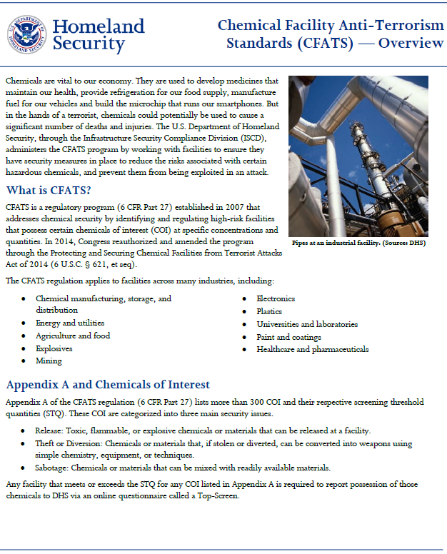
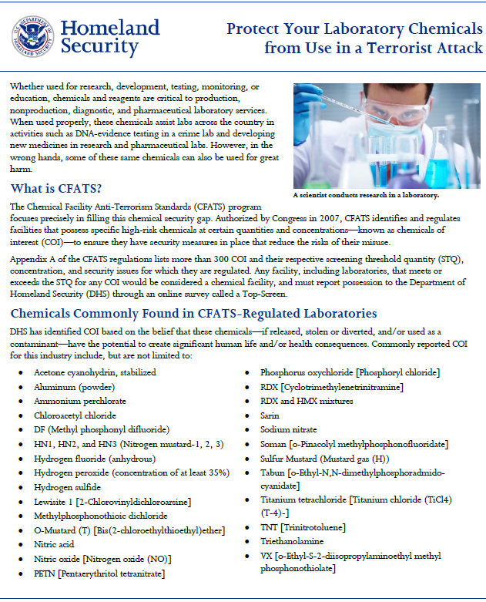
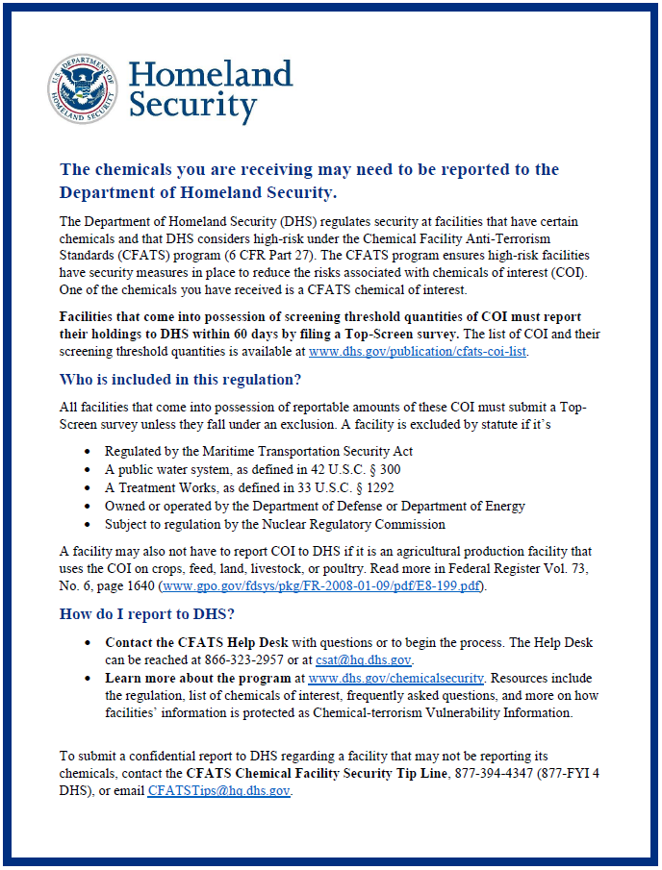
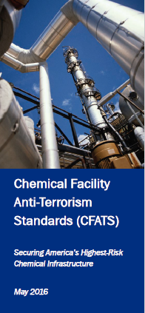
Outreach Resources
DHS is committed to promoting chemical security awareness through outreach and fostering relationships within communities. CFATS continually develops new outreach resources in support of its outreach efforts and commitment to provide stakeholders with informative resources, including:
CFATS Overview Fact Sheet
CFATS First Steps Fact Sheet
Top Regulated COI Fact Sheet
Appendix – A Trifold
Shipping and Receiving COI Flyer
RBPS Specific Fact Sheets
Industry Specific Fact Sheets

Slide 23
Available Resources
Outreach: DHS outreach for CFATS is a continuous effort to educate stakeholders on the program.
To request a CFATS presentation or a CAV, submit a request through the program website www.dhs.gov/cfats, or email DHS at CFATS@hq.dhs.gov.
CFATS Help Desk: Direct questions about the CFATS program to the CFATS Help Desk.
Hours of Operation are Mon. – Fri. 8:30 AM – 5:00 PM (ET)
CFATS Help Desk toll-free number 1-866-323-2957
CFATS Help Desk email address csat@dhs.gov
CFATS Web Site: For CFATS Frequently Asked Questions (FAQs), CVI training, and other useful CFATS-related information, please go to www.dhs.gov/cfats

Slide 24
The DHS signature may be displayed alone on a slide to cue the speaker that they have reached the end of the presentation.
If a question and answer session follows the presentation, this slide can be projected during this time.

